Slide 1
Topic Olfactory Sensing
Professor
Syed Azeemuddin
Teaching Assistant
Giri Prasath
Team 15
Palash Sharma (2019101082)
Archit Jain (2019101053)
Pulkit Gupta(2019101078)
Aryan Jain (2019101056)
Bhavya Jain (2019101095)

Slide 2
Problem Statement
LPG gas leakages are a big problem in homes and commercial spaces. Design a system that tracks LPG gas levels and in case of a leak, an alert message can be delivered.

Slide 3
Our Solution
An IoT based system that shall monitor the real time levels of gas in proximity of gas cylinders and raise an alarm email if levels of gas go above allowed level.
Data shall be stored in an OneM2M server and stored securely to enable privacy and option to analyze sensor data via an interactive dashboard.

Slide 4
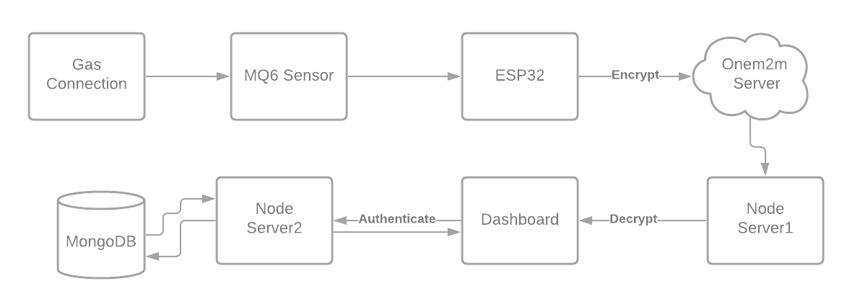
Block Diagram

Slide 5
Hardware Components
MQ-6 Gas Sensor
ESP 32 module
Battery
Connecting wires
0.96-inch OLED Display
RTC (Real Time Clock)
Bread Board
10k Ω Resistors

Slide 6
Sensor
MQ line of sensors become an obvious option for detecting LPG gas leakages since they are sufficiently sensitive to gases and operate at low voltages and power supply and are also economically viable.
MQ-6 (Choice)
Specific to LPG gas detection.
More sensitive to small quantities of gas
Long life and low cost.

Slide 7
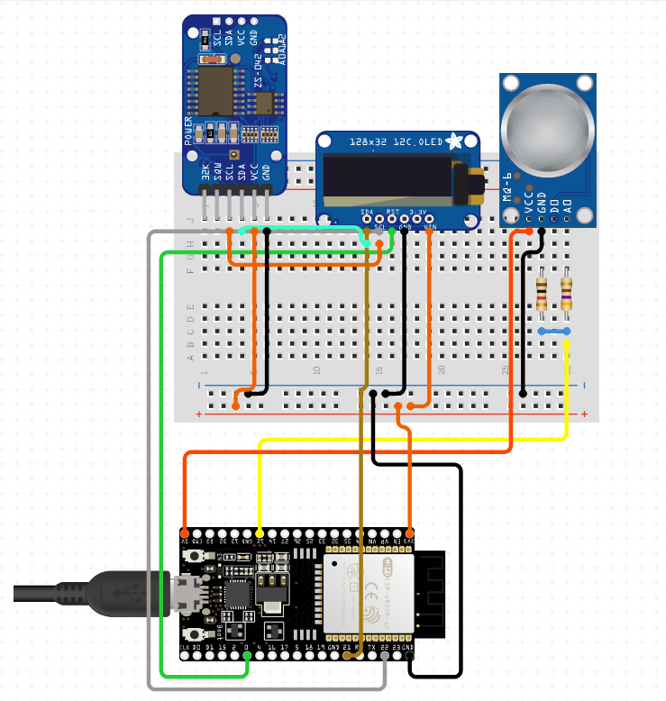
Circuit Diagram

Slide 8
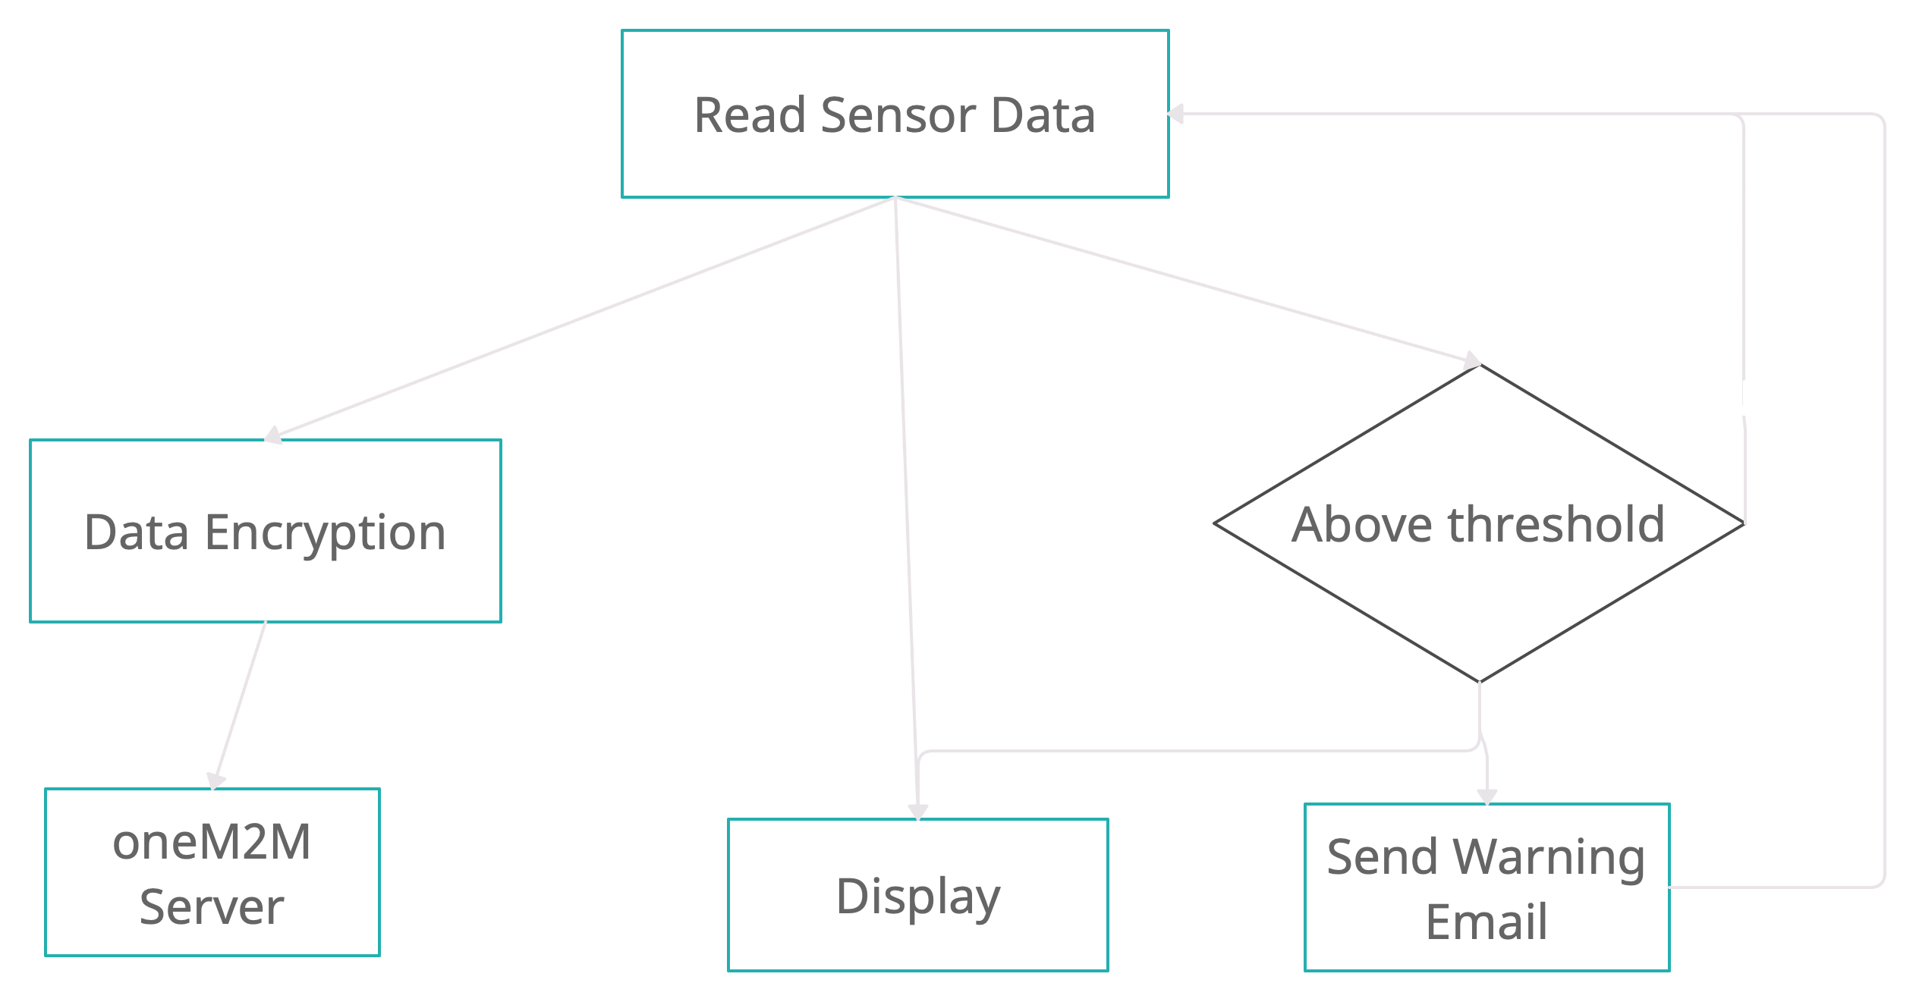
Arduino code Flowchart

Slide 9
Dashboard
Login/ Register: The User can create an account using a pre-registered Node with its node id and login to the platform using the credentials set during signup.
Dashboard currently has 3 sections, and all have auto refresh.
Home section of the dashboard shows 20 latest readings along with graph plotted for the same.
Alert section of the dashboard shows all high risk reading above a threshold for with he got a mail by our system.
User can see all the data collected in data section as well.

Slide 10
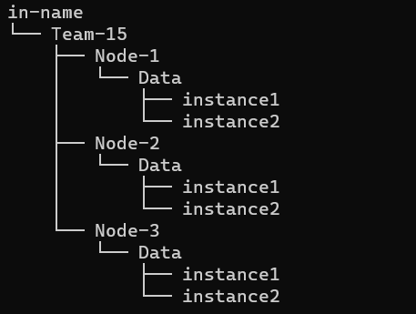
Interoperability - oneM2M
Used oneM2M server to enable interoperable and secure service.
String CSE_IP - “esw-onem2m.iiit.ac.in”
String CSE_NAME - “in-name”
Connectivity – Wi-Fi
Data format – XML
Application Protocol – RESTful HTTP
oneM2M Resource Tree

Slide 11
Security
Encryption and decryption of data using AES-ECB 128 bit.
Encryption keys and user details are stored in MongoDB cloud database.
User authentication in user dashboard.
Using HTTP protocol for sending and receiving data.
Using two servers one for retrieving data from OneM2M server and other for keys for decryption.
Used CORS for secure cross-origin requests and data transfers between browser and server.

Slide 12
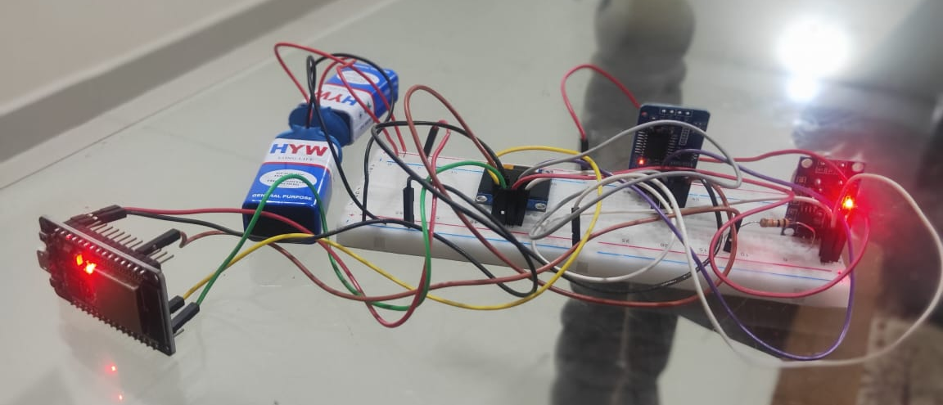

Data Calibration and Robustness
$finalReading=\left(\frac{analogReading}{4095}\right)∗5000 (in mV)$
Our system is robust and can also work on batter power

Slide 13
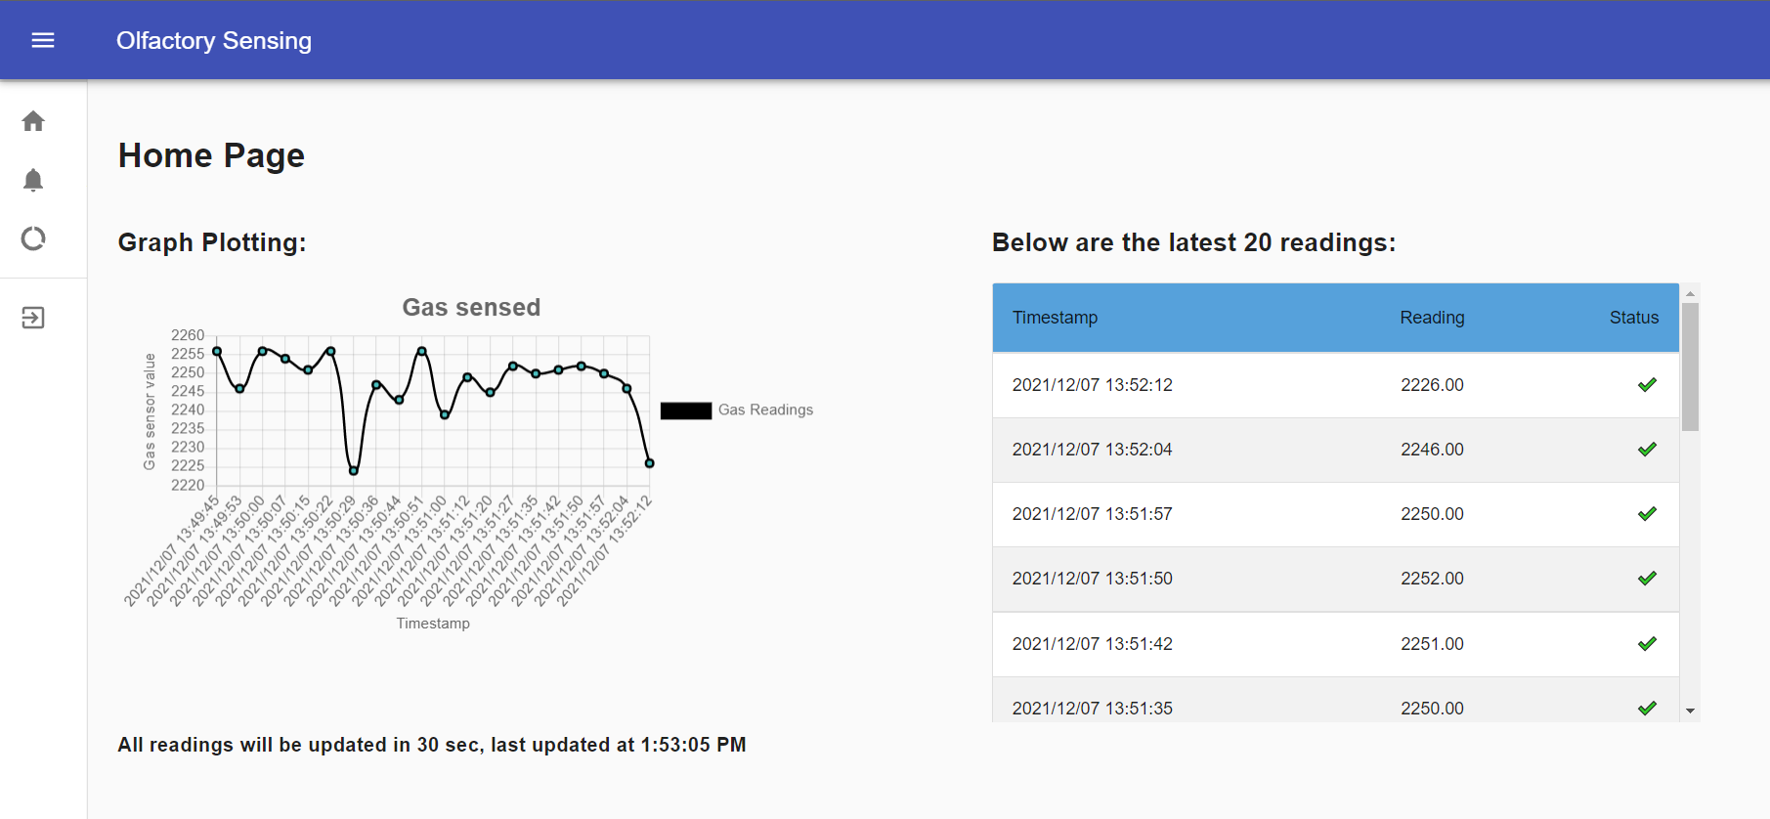
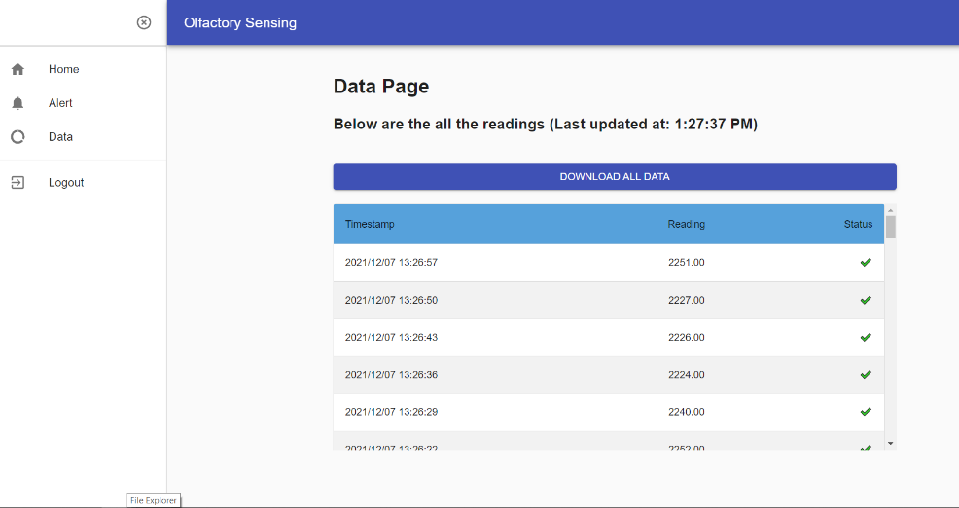
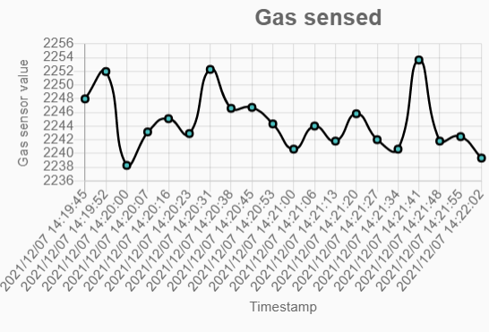
Data visualization via User Dashboard
Encrypted data from oneM2M server comes here and displayed in the from of graph and table and user can also download the data if he/she wants.

Slide 14
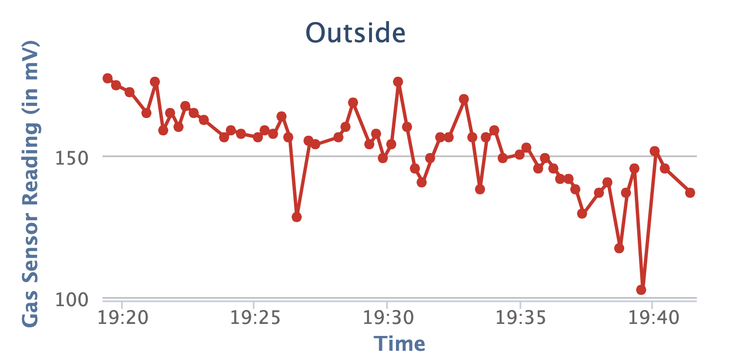
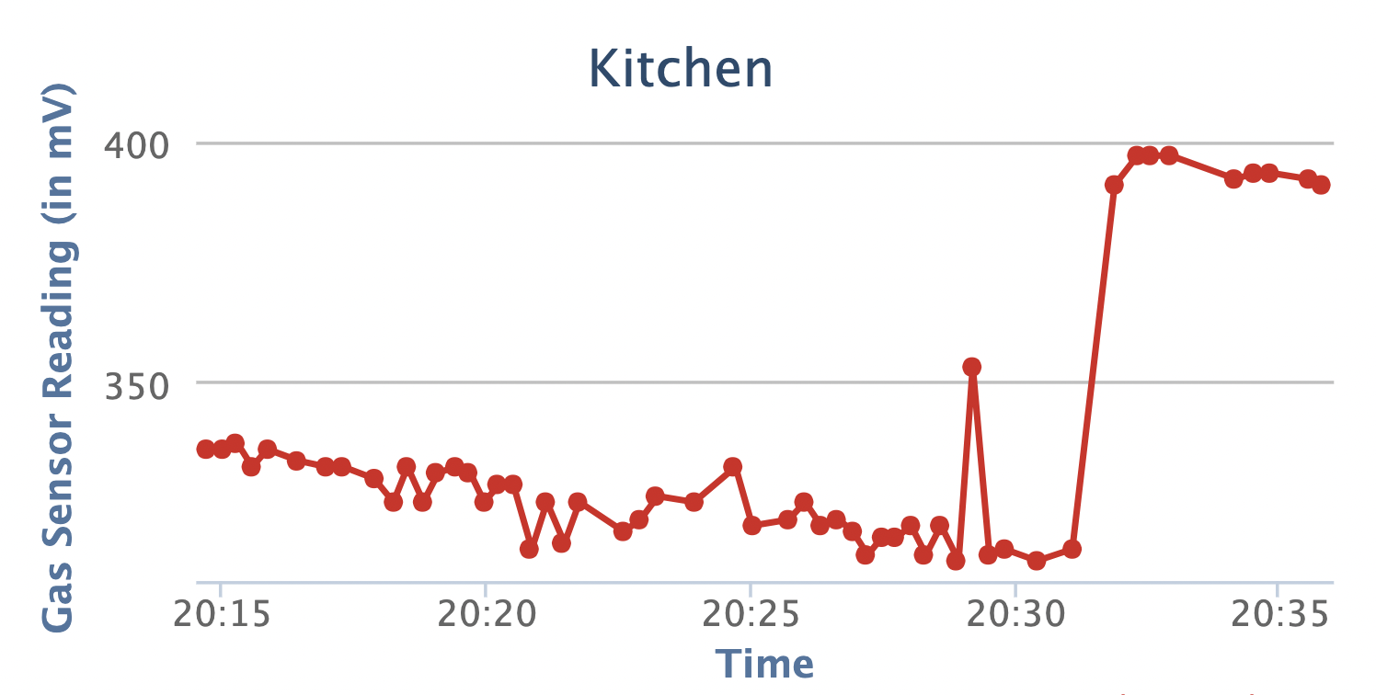
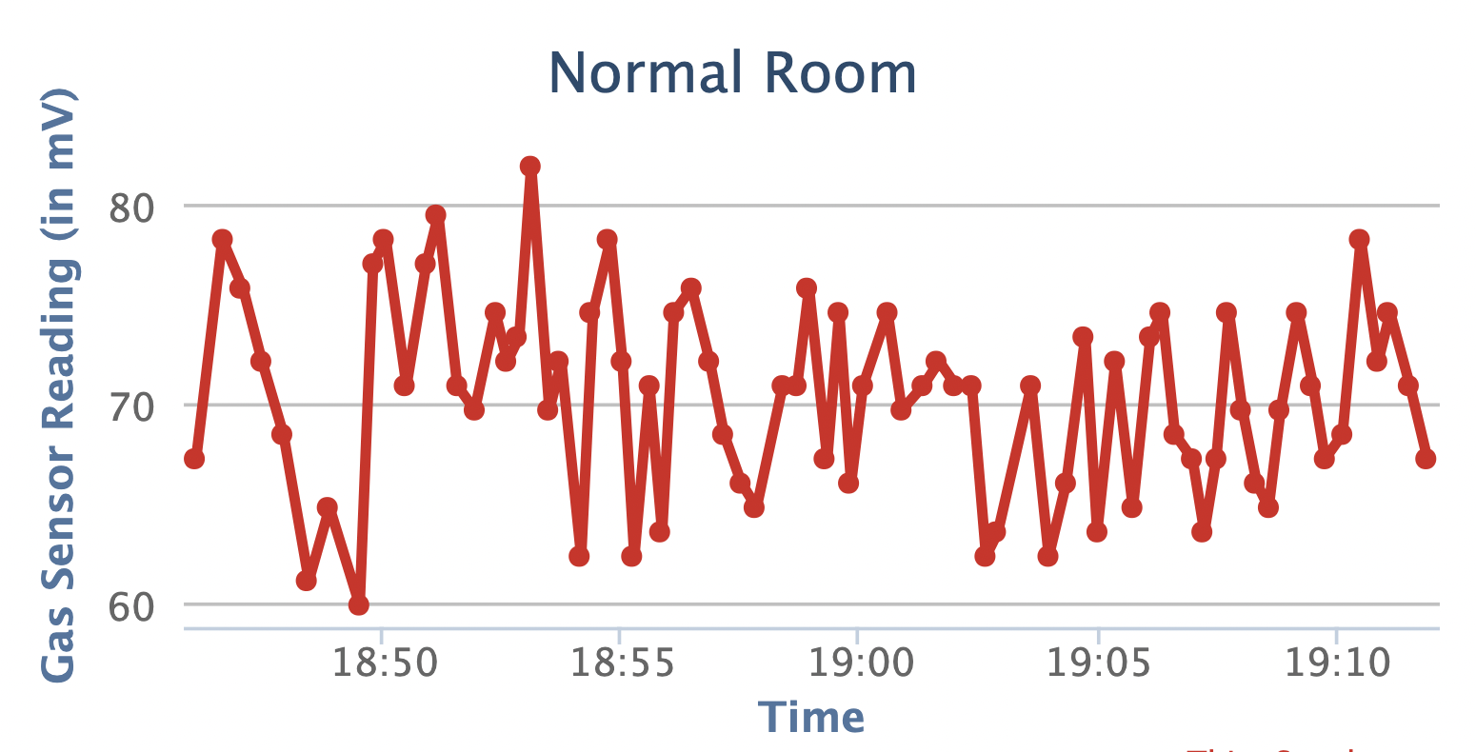
Analysis
Figure 1: Outside
Figure 3: Kitchen
Figure 2: Normal Room

Slide 15
Inferences
 | Median(in mV) | Mean(in mV) | Mode(in mV)
Normal Room | 72.03 | 68.97 | 70.81
Outside | 145.29 | 145.94 | 156.28
Kitchen | 332.11 | 377.81 | 324.78

Slide 16
Uses
To sense the presence of hazardous LPG gas leakage.
Sensing with accuracy will also prevent from any explosive tragedy to happen.
To prevent the wastage of large amount of gas which is leaked.
To have a surety check for LPG gas cylinder, before installation.

Slide 17
Challenges Faced
Connecting to oneM2M remote server via Arduino
Wi-Fi of ESP32 masking the sensor pin
Successful encryption of data and decryption

Slide 18
Timeline
September
November
Testing sensor code and circuit creation in Tinkercad
Adding security layer, calibration and finalizing the system by testing.
Planning and Simulation | Time for Action | Time to Test | Time to Finish
October
December
Working on hardware and integrating all components of project along with setting up oneM2M, user dashboard and email through Esp32
Aanalysing data and documentation

Slide 19
Individual Contribution
Archit Jain & Aryan Jain
MongoDB database - Store user profile and encryption keys
Auth Server - It connects with the MongoDB database and is used for authentication purposes.
Dashboard UI - It enables the user to track the reading with graph and tabular data
Palash Sharma & Pulkit Gupta
Hardware - Arduino Collecting Sensor data, sending to oneM2M and sending alert emails
Sending data to onem2m server from Arduino
Security includes encrypting and decrypting data
Calibration and Documentation is done by all four of us.

Slide 20
System Demo

Slide 21
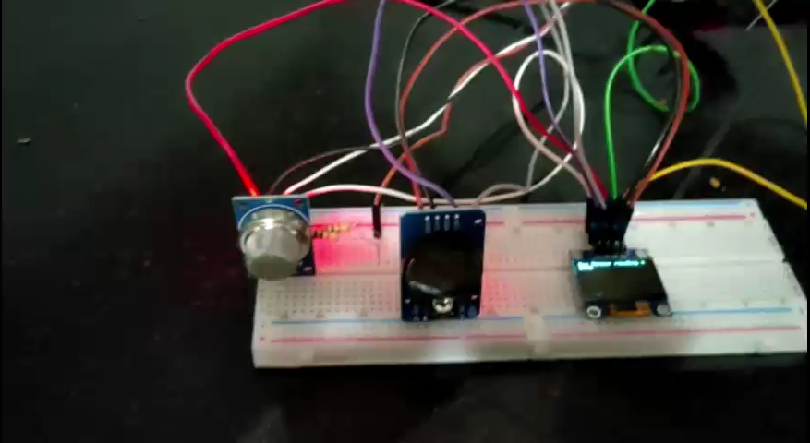

Slide 22
Dashboard Demo

Slide 23

- Team 15
Archit Jain
Aryan Jain
Palash Sharma
Pulkit Gupta
Bhavya Jain

